Slide 1
Module 1: Introducing Siebel Applications
Siebel Core Developer and Technology School
Notes:
Time: Lecture: 30 minutes; no lab
Intent: To introduce the Siebel applications and provide context for this course.
Flow: Customer relationship management (CRM); Siebel CRM Enterprise, Siebel CRM Professional Edition, and Siebel CRM OnDemand; Siebel business entities; employee, customer, and partner applications; the types of user interfaces (UIs); examples of the various products.
Key Terms:
Customer relationship management (CRM)
Installed applications
Hosted applications
Siebel CRM Enterprise
Siebel CRM Professional Edition
Siebel CRM OnDemand
Business entities
Employee applications; customer and partner applications
High and standard interactivity
Please note: Faculty-specific notes are italicized.

Slide 2

Module Objectives
After completing this module you will be able to:
  Describe Siebel applications
  Describe standard Siebel terminology and user interface behavior
  Describe Siebel employee, customer, and partner applications
Why you need to know:
  You need to be familiar with Siebel applications to understand the context of this course
  You will work with employee and customer applications throughout this course
Notes:
Each objective and “why you need to know” should be stated aloud.

Slide 3
Siebel Customer Relationship Management (CRM)
Enables you to manage all customer touchpoints through email, telephone, fax, the Web, or in the field
  Synchronizes all touchpoints through one central information repository, one database, one tool set, and one architecture
  Provides your customers with a consistent view of the company and your company with a consistent view of the customers
Includes installed and hosted applications to align with your current and future business requirements
  Extends your CRM solution to everyone in your employee and partner organizations
Notes:
Siebel Systems provides both installed or on-premises solutions and hosted applications. Refer to the student note for definitions.
The Siebel CRM solution enables organizations to manage all customer touch points—via email, telephone, fax, the Web, or in the field.
Customer touch points are synchronized through one central information repository, one database, one tool set, and one architecture regardless of whether they are interactions that occur over the Internet, through a call center, or by field service agents or channel partners.
With the Siebel CRM solution, the customer has a consistent view of the company, and the company has a consistent view of the customer. This leads to higher customer satisfaction and higher employee satisfaction.

Slide 4
Siebel CRM Enterprise
An installed solution that provides an integrated product suite with functionality tailored to more than 20 specific industries
For a complete listing,
see Siebel Bookshelf
or www.siebel.com
Business Processes
Industry Applications
Siebel Communications
Siebel Consumer Sector
Siebel Energy
Siebel Financial Services
Siebel Life Sciences
Siebel Manufacturing
Siebel Public Sector
Siebel Travel & Transportation
Siebel Mobile Solutions
Siebel Handheld
Siebel Wireless
Siebel Voice
Employee Applications
Siebel Call Center
Siebel Service
Siebel Sales
Siebel Field Service
Customer Applications
Siebel Configurator
Siebel Pricer
Siebel Orders
Siebel Sales Catalog
Siebel Advisor
Siebel eSales
Siebel eService
Partner Applications
Siebel Partner Manager
Siebel Partner Portal
Siebel Analytics
Siebel Architecture
Notes:
Siebel Enterprise CRM provides an integrated product suite to help manage customer relationships across all communication channels, such as the Web, email, telephone, fax, or the field. Siebel products are configured using a single application, Siebel Tools.
The graphic on this slide displays the high-level categories for the industry applications. Please emphasize that students should refer to Siebel Bookshelf or www.siebel.com for a complete listing of the industry applications.
Emphasize to the students that while each application may have a different data model, or incorporate industry-specific terms, all applications are built on the same technology and will have a familiar user interface and functionality.

Slide 5
Siebel CRM Professional Edition
An installed solution designed for companies with fewer than 100 users
  Provides a family of multichannel sales, customer service, and marketing applications
Business Processes
Industry Applications
Siebel Finance, Professional Edition
Siebel Insurance, Professional Edition
Siebel Healthcare, Professional Edition
Customer Applications
Siebel Quote & Order, Professional Edition
Siebel Product & Catalog, Professional Edition
Siebel Pricing & Contract, Professional Edition
Employee Applications
Siebel Call Center, Professional Edition
Siebel Sales, Professional Edition
Siebel Service, Professional Edition
Partner Applications
Siebel Partner Manager, Professional Edition
Siebel Partner Portal, Professional Edition
Siebel Architecture
Notes:
Siebel CRM Professional Edition was previously known as Siebel MidMarket Edition.
The student note provides an explanation of the difference between Siebel Enterprise and Siebel CRM Professional Edition. Refer to the Siebel Bookshelf or www.siebel.com for more information about Siebel CRM Professional Edition.

Slide 6
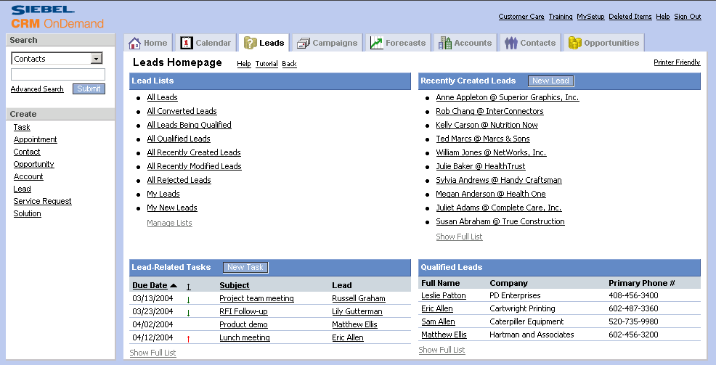
Siebel CRM OnDemand
A hosted solution that provides core functionality to casual users, business partners, and remote divisions
  Available on a per-user basis through a monthly subscription
For more
information, see www.crmondemand.com
Notes:
Siebel CRM OnDemand provides CRM functionality with little or no configuration and hardware investment.
Siebel CRM OnDemand can be implemented in conjunction with your Enterprise and Professional solutions to support all the different users within your organization. For example, heavy users such as sales managers or call center representatives require a fully functional CRM application. In contrast, light, or casual users, such as manufacturing managers in remote plant locations require a simple, easy-to-use CRM application with core functionality. Siebel CRM OnDemand can be implemented for these users on a subscription basis, per user/per month, with limited investment or IT resources.
Additionally, Siebel CRM OnDemand can be implemented by small companies that have limited or no IT staff. Refer to www.crmondemand.com for more information.

Slide 7
Siebel Business Entities
Accounts
Contacts
Opportunities
Orders
Service requests
Activities
Assets
Notes:
Siebel is built on one common architecture. This means customers have one place to make configuration changes, which minimizes integration cost and difficulty. On top of this common architecture, we build horizontal applications for Customers, Call Centers, Field Agents, and Channel Parents. Siebel’s product suite consists of a set of core modules otherwise known as Business Entities. Siebel software is purchased in a modular format starting with a base set of modules. For example, Siebel Sales base modules are Accounts, Contacts, Activities and Opportunities. Some of Siebel’s Business Entities include:
Accounts. Accounts allow sales and customer service reps and teams to track customers or potential customers. Account is a business external to your company, it represents a current or potential client, a business partner, or a competitor.
Contacts. Contacts allow users to manage both business and personal contacts. Contact is a person with whom you do business and has the following characteristics: Name, Job Title, Email Address.
Opportunities. Opportunities allow sales reps and teams to track potential sales or other revenue-generating events. Opportunity is a potential revenue generating event with the following characteristics: Possible association with an account, Potential revenue, Probability of completion Close date.
Orders. Orders are products or services purchased by your customers Have the following characteristics: order number, status and priority, associated account
Service Requests. Service Requests allow service reps to create and access information on a customer’s request. Service Request is a request from a customer for information or assistance with a problem related to products or services purchased from your company, it has the following characteristics: Status, Severity, Priority.
Activities. Activities track tasks and events that are performed for a contact, account, or an opportunity. Activity is a specific task or event to be completed and has the following characteristics: Start date and due date, Priority, Assigned to specific employees for completion.
Assets. Assets are an instance of a purchased product and have the following characteristics: Asset Number, Product and Part Number, Status.
Note: Depending on which applications the customer uses, the terminology may be different. For example, Contacts are called Professionals in ePharma. Accounts may be called Companies in another application. All of these terms (accounts, opportunities, contacts, service requests, activities, and assets) may be used in the Call Center application.

Slide 8
Types of Siebel Enterprise Applications
Employee applications
  Are used by internal employees
  Examples include:
    Siebel Call Center
    Siebel Sales
Customer and partner applications
  Are used by customers and partners
  Examples include:
    Siebel Customer Order Management
    Siebel Partner Relationship Management (PRM)
Notes:
In the next few slides, employee, customer, and partner applications are presented at a very high level. Refer back to slides 4 and 5 for more examples of employee, customer, and partner applications.

Slide 9
Types of User Interfaces (UI)
High-interactivity (HI) mode
  Is available for employee applications, supporting highly interactive enterprise users
  Requires Internet Explorer 5.5 SP2 or 6.0 with SP1 and supports additional usability features such as drag-and-drop for setting column widths and positions
Standard-interactivity (SI) mode
  Are available for customer applications
  Use a wide variety of browsers and behaves like traditional Web applications, requiring frequent page refreshes
Notes:
Traditional Web applications follow a model whereby almost every user action results in a page refresh. Some of the user actions that can trigger a page refresh are: a user changing the quantity of an item in the Shopping Cart, a user inserting a new appointment in the calendar, and a user selecting a different item from a list to see its details.
These frequent page refreshes not only slow down users by forcing them to wait for new pages, but also waste time as users reorient themselves with the frequently changing context caused by these page refreshes. In addition, frequent page refreshes are expensive in terms of network bandwidth utilization, as each page refresh requires the same HTML information, already displayed in the browser, to be downloaded with new data. These limitations of traditional Web technology make it unsuitable for world-class enterprise applications such as call center and sales force automation.
The Siebel high interactivity framework solves the problem of lowered employee productivity and high bandwidth requirements by reducing the number of page refreshes. The high interactivity framework depends on capabilities that are only available in later version browsers (for example, Internet Explorer 5.5 or 6.0), and is only used for employee applications such as Siebel Sales and Siebel Call Center. Customer applications such as Siebel eSales, Siebel eService do not use high interactivity framework, and are called standard interactivity applications.
Another benefit of high interactivity is that it allows for extensibility and integration.
Extend applications by integrating them with third-party software on the client side
Make Siebel business objects available on the client side
Instructors should demonstrate the differences between the high interactivity and standard interactivity UIs. For example, show the UI for Call Center and Service noting the different placements of the Service tab.
Note: Standard-interactivity + mode (SI+) provides much of the same functionality as high-interactivity mode, but at the time of this printing, SI+ mode was not officially available to customers.

Slide 10
Differences between User Interfaces
The differences between High and Standard Interactivity
The following features are supported only by high interactivity
  Client-side scripting
    With access to Siebel objects on the client side
  Interactive controls
    Calculator, calendar date/time selector
  Implicit Save
    Saves the record without having to press the save button
Notes:
Some of the differences between standard and high interactivity applications are as follows:
Support for client-side scripting. Client-side scripting is available for high and standard interactivity applications. The main difference here is that in high interactivity, customers have access to Siebel objects through which they can build data validation logic on the client side to further reduce the number of page refreshes needed for high interactivity applications.
Support for interactive controls. High interactivity applications employ specialized JavaScript controls for drop-downs, date and time, lists, and so on. These controls provide greater levels of interactivity than traditional HTML controls that appear in standard interactivity applications. For example, the list control supports resizing of columns, and drop-down lists support auto-completion.
Support for Application level menus. Application level menus require support for Java applets. Since there is no support for Java applets in standard interactivity, there are no application level menus.
Support for Implicit save. High Interactivity applications support an implicit save model whereby navigating off a record causes the changes to be saved for that record. In standard mode, an explicit save needs to be invoked which means users must physically press a save button to commit any changes to the database. Simply stepping off a record in standard mode will lose all changes made to that record.

Slide 11
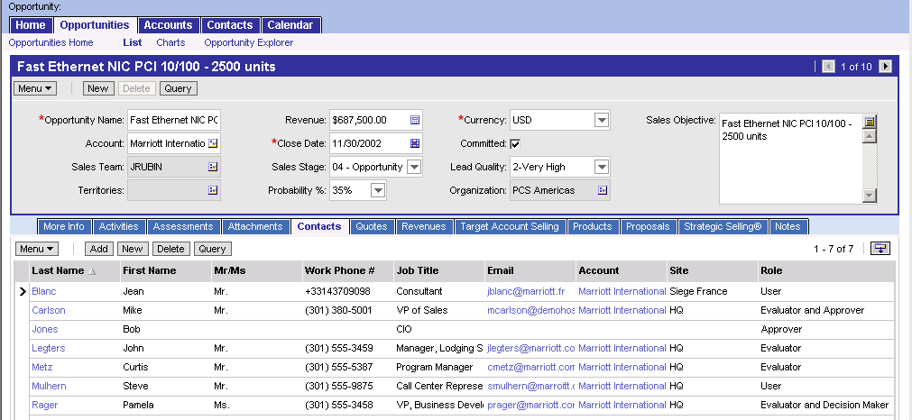
Employee Application: Siebel Sales
Allows your sales force to manage accounts, sales opportunities, and contacts
  Helps identify top opportunities and specific actions to better manage those opportunities to a more rapid closure
Siebel Sales Opportunities view
Notes:
This is an example of the Siebel Sales application, using the high-interactivity UI.
Note how the home page uses personalization to welcome the user. Also note how data access rules limit the data. For example, the opportunities and expenses are specific to the logged in user. Access Controls will be discussed later in the course.
Note the screen tabs at the top of graphic. Clicking one of these tabs will navigate the user elsewhere in the application. Screens and views will be discussed in more detail in the next module.

Slide 12
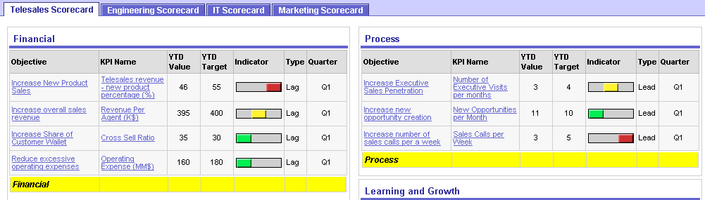
Employee Application: Siebel Call Center
Enables customer service and telesales representatives to:
  Provide customer support
  Generate customer loyalty
  Increase revenues through effective campaign execution, cross-selling, and up-selling
Part of the Agent Metrics Dashboard.
Notes:
This is an example of the Siebel Call Center application, using the high-interactivity UI.
A key point regarding the different application types presented in the next few slides: they are all built upon the same architecture and database.

Slide 13
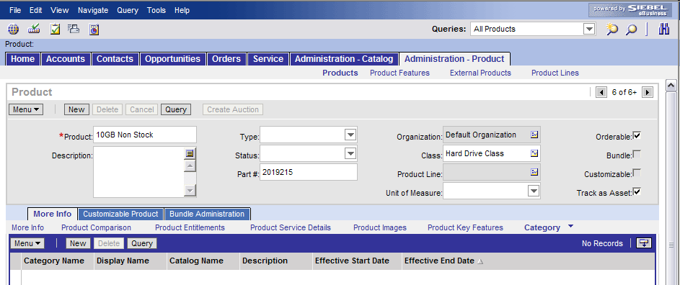
Customer Application: Sales Catalog
Allows companies to develop, manage, and deliver dynamic product catalogs across all customer channels
Product Administration Screen
Notes:
This is an example of the Siebel eService administration screen.

Slide 14
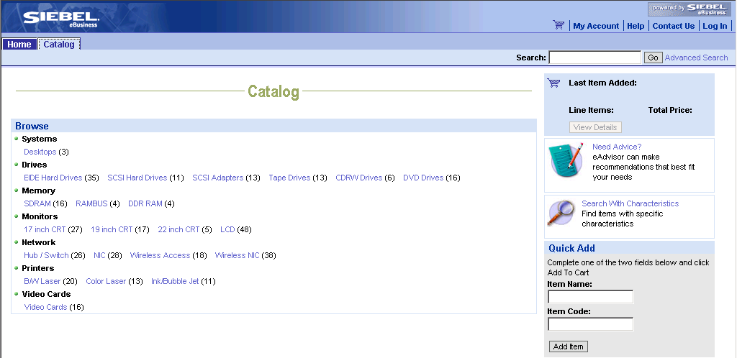
Customer Application: Siebel eSales
Allows your customers to purchase products over the Web
Includes an interactive product catalog, search and product comparison mechanisms, and online ordering capabilities
eSales Catalog screen
Advisor
Quick Add to
shopping cart
Browse products
Notes:
This is an example of the Siebel eSales application, using the Standard-Interactivity UI. Notice that there are fewer screen tabs.
Customer applications can be accessed from a URL without logging in. Once a user logs in, the content is personalized for the user. For example, the shopping cart would be personalized for the user.
Siebel Advisor acts as a virtual sales advisor and recommendation assistant that provides situational advice through interactive questions and customer choices to engage customers across multiple channels—including the Web, telesales, direct sales force and dealer networks.

Slide 15
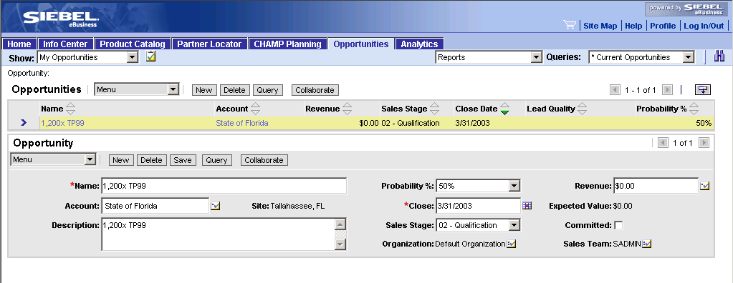
Partner Application: Siebel Partner Portal
Allows partners to communicate, collaborate, and conduct business with a Web-based interface
Includes product information, training, sales tools, transaction data, and performance analysis reports
Partner Portal Opportunities screen
Notes:
This is an example of the Siebel Partner Portal application, using the standard-interactivity UI.
Employees and partners can access information relating to the same accounts (for example) that they are working on. Due to data access rules; however, the partner could have limited access to data related to the accounts. For example, the partner might be allowed to see contacts, but not orders. Access Controls will be covered in more detail later in the course. Recommended items are personalized based on the user logged in to the application.

Slide 16
Applications Used in this Course
Siebel Call Center, Siebel Sales, and Siebel eService are used during this course
  Technology learned here applies to all Siebel applications
Configuration of Siebel applications is performed using Siebel Tools
For information on all other Siebel CRM Applications, see:
  Siebel Bookshelf
  www.siebel.com
Notes:
The Call Center, Partner Manager, and the Partner Portal applications will be used during the Case Study week of the Core Consultant Course.

Slide 17
Siebel Applications
Are built on a common architecture and allow you to implement business processes based on the standard functionality
  Facilitates the implementation and adoption of the applications
Share a common database between multiple Siebel applications
  Makes a common set of data available to all applications
Are designed to be implemented with minimal configuration
  Address user requirements by implementing the standard Siebel application functionality
Can be tailored to meet specific business requirements
  Keep modifications to a minimum to ensure the success of your Siebel application implementation
Notes:
Customers can deploy one or more Siebel applications to meet their business requirements. The integrated products are designed to work together. Prebuilt functionality provides deployment with little or no configuration. Students will learn how to configure the application later in the course. If the customer does not want to configure the application, the standard application can be deployed.
For example, the customer’s company could be using the Call Center, Field Service, and Marketing applications in different departments, yet all are accessing the same database. Thus, all the information coming from the different touch points is aggregated to produce an integrated picture of the account and contact relationships with the company.
The recommended approach for a Siebel product implementation is to implement the purchased functionality with minimal modifications, rather than encouraging extensive modifications to the purchased application.
Approaches and best practices for successful Siebel application implementations are discussed in a later module.

Slide 18
Summary
This module showed you how to:
  Describe Siebel applications
  Describe standard Siebel terminology and user interface behavior
  Describe Siebel employee, customer, and partner applications
Notes:
Review Question: What is a business entity?
Answer: A business entity is something in the real world in which we have a business interest.
Review Question: What are some of the business entities used in Siebel applications?
Answer: Accounts, Contacts, Opportunities, Orders, Service Requests, and so on.
Review Question: How are employee applications different from customer and partner applications?
Answer: Employee applications support high interactivity (HI) mode. Customer and partner applications support standard interactivity (SI) mode.
Review Question: Name the two types of user interfaces.
Answer: High interactivity (HI) mode and standard interactivity (SI mode)

